Slide 1

RUNGTA COLLEGE OF DENTAL SCIENCES & RESEARCH
TITLE OF THE TOPIC : Support in Complete Denture
DEPARTMENT OF PROSTHODONTICS AND CROWN & BRIDGE

Slide 2
Specific learning Objectives
At the end of this presentation the learner is expected to know ;
Core areas* | Domain ** | Category #
Definitions | Cognitive | Must Know
Support | Cognitive | Must Know
Factors effecting support | Cognitive | Must Know
Conclusion | Cognitive | Must Know
Take home message | Cognitive | Must Know
References | Affective | Desired to know

Slide 3
Contents
INTRODUCTION
PRINCIPLES AND OBJECTIVE OF IMPRESSION MAKING
SUPPORT
Types of Support
Nature of Supporting tissue
Anatomical consideration
CONCLUSION
REFERENCES

Slide 4
INTRODUCTION
The recognition, understanding and incorporation of certain, mechanical, biologic and physical factors are necessary to ensure optimal complete denture treatment.

Slide 5
These factors are determinants that promote the properties of retention stability and support in the finished prosthesis
Biological factors
Physical factors
Mechanical factors
retention stability support
Psychologic Physiologic longevity
comfort comfort
Prosthesis success

Slide 6
Retention, support &stability are important for success.
Psychological comfort
Retention
Support
Stability
Physiologic comfort
Longevity

Slide 7
The objectives of an impression are to provide: (given by winkler)
Retention
Stability
Support for the denture
Support for the lips
Preservation of the residual alveolar ridges and soft tissues
Esthetics

Slide 8
SUPPORT
the resistance to vertical forces of mastication and to occlusal or other forces applied in the direction towards the basal seat. (GPT 8)
According to Boucher,
Support is the resistance of a denture to the vertical components of mastication and to occlusal or other forces applied in a direction towards the basal seat.

Slide 9
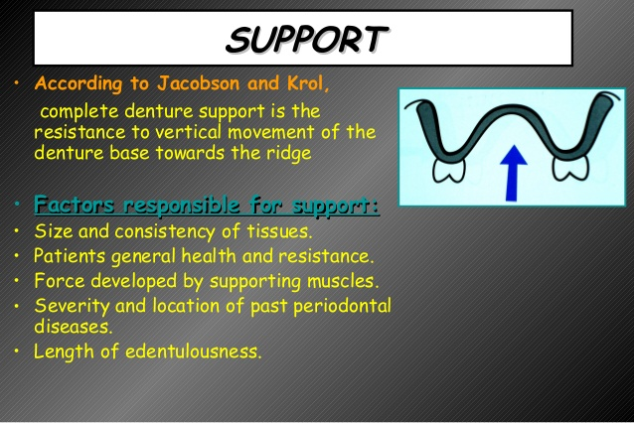

Slide 10
Types of support
INITIAL SUPPORT -achieved by using impression procedures that provide optimal extention and functional loading of the supporting tissues, which vary in their resiliency.
LONG TERM SUPPORT-directing the forces of occlusal loading toward those tissues most resistant to remodeling &resorptive changes

Slide 11
Effective support is realized when
Cover maximal surface area without impinging on movable or fragile tissues
Tissues capable of resisting resorption are selectively loaded during function
Tissues capable of resisting vertical displacement are allowed to make firm contact with denture base during function
Compensation is made for the varying tissue resiliency to provide for uniform denture base movement under function
Maintain a harmonious occlusal relationship.

Slide 12
Snow shoe principle
It is maximum extension of denture base depicts that under a constant load, by maximum extension of denture base there will be less stress per unit area under the denture base causing decreases tissue displacement, and reduces denture base movement.

Slide 13
NATURE OF SUPPORTING TISSUES
Soft tissue
Keratinized, firmly bound mucosa -better resist stress.
Nonkeratinized alveolar mucosa -not well adapted to tolerate the functionally generated stresses of a denture base.
Resilient submucosa permits moderate compressibility without mechanical impingement of the mucosa between the denture base and underlying bone. The fatty and glandular submucosa act as hydraulic cushion.
Regions, which possess a thin or less keratinized mucosa over bone without an intervening layer of submucosa, should be relieved or recorded without displacement.

Slide 14
Hard tissue
Rate & amount of bone loss and remodeling that occur in the anterior maxilla and mandible are of serious concern in prosthodontics.
Minimizing the pressures in those regions most susceptible and directing the forces towards those regions relatively resistant to resorption can help to maintain healthy residual ridges.

Slide 15
Bone factor
Pressure-tension concept appears to play an important role in the destruction or preservation of the bone of the residual ridge. Pressure stimulates resorption whereas tension maintains the integrity or actually causes deposition of bone.
Most forces applied beneath the dentures result in pressure and subsequent resorptive changes.

Slide 16
Cortical bone more resistant to resorption than cancellous or medullary bone.Regions of muscle fiber and tendinous attachments to cortical plate through sharpeys fibers ensure tension on bone.
Classical example of muscle attachment enhancing the resistance to remodeling is often seen in severely atrophied mandibular edentulous ridges. These mandibles exhibit prominent mylohyoid ridges, genial tubercules and mental protruberances

Slide 17
It is therefore a keratinized masticatory mucosa firmly bound to underlying cortical bone through a variable zone of connective tissue and submucosa with associated muscle attachments that provide the ideal denture bearing tissue.

Slide 18
MANDIBULAR ANATOMIC CONSIDERATIONS
Primary stress bearing regions on mandible include pear shaped pad and the buccal shelf.
Buccal shelf -primary support area- usually covered by mucosa with an intervening submucous layer contains glandular connective tissue & buccinators muscle fibers.

Slide 19
Role of mandibular residual ridge crest in support depends on the nature of the ridge and the bone factor.
-Patient exhibiting broad, square, well developed residual
ridges covered by firmly bound masticatory mucosa plus a
favorable intrinsic bone factor may rely on ridges for support.
-Generally, the ridge crests are reserved as secondary support
areas. Lack of muscle attachments & presence of cancellous bone
usually result in resorptive changes occurring more rapidly than
in the area of primary support.

Slide 20
MAXILLARY ANATOMIC CONSIDERATIONS
In the maxillae the horizontal portion of the hard palate lateral to the midline raphe -provide primary support.
Crest of ridge also important in denture support. The soft tissue is often thick, keratinized, and firmly bound to the periosteum & underlying bone.
Remaining facial slopes - not essential in denture support. Nonkeratinized alveolar mucosa cannot tolerate functional stresses, and the inclined surface would provide little resistance to vertical base movement.

Slide 21
RELIEF REGIONS
First, tissues susceptible to resorption should not be subjected to functional pressures -some maxillary and most mandibular ridge crests.
Second are those regions that have a thin mucosa directly over hard cortical bone- palatal midline raphe, tori and exostoses & the lingual surface of the mandible, especially the mylohyoid ridge.
Third are those regions of mucosa overlying neurovascular bundles such as the incisive papilla and mental foramen.
Should be recorded at rest or relieved according to the techniques used.

Slide 22
CONCLUSION
For a denture to carry out its function well, it is obvious that it must have good retention, stability support.
These properties are closely interlinked and usually complement each other and the factors that contribute these properties are highly interrelated.
The dentist must have a good knowledge of the denture environment &biomechanical factors in order to provide the best chances for success.

Slide 23
Take Home message
Understanding the factors of support is very important in better distribution of load.
Proper placement and distribution of load on stress bearing area helps in successful of dentures

Slide 24
REFERENCES
Zarb A.G. Bolender L.C Boucher’s Prosthodontic treatment for edentulous patients 12th edition.
Arthur R.F. Complete denture stability related to tooth position. J. Prosthet. Dent. 1961; 11: 1031-37.

Slide 25
Suggestive reading
A contemporary review of the factors involved in complete denture retention, stability, and support. Part 1: retention T. E. Jacobson, A.J. Krol. JPD 1983, 49:5-15.
T.E. JACOBSON and J. KROLL :A contemporary review of the factors involved in the complete dentures. J PROSTHET DENT 49:2,1983.
A contemporary review of the factors involved in complete dentures. Part 3 support. J P D 1983; 49(3) ; 306 - 313
FRIEDMAN.S.: Edentulous impression procedures for maximum retention and stability. J PROSTHET DENT 7:14,1957.
BECKER C.M et.al, :Lingualized occlusion for removable prosthodontics. J PROSTHET DENT 38:601,1977.

Slide 26
Questions for assignment
Long questions 10x2=20
Elaborate Factors responsible for support in detail ?
Describe the considerations for stability in complete denture prosthesis?
Short notes 5 x3=15
Define Stability and support?
What is snow shoe principle?
Short note on Modiolus?

Slide 27

THANK YOU

